Slide 1
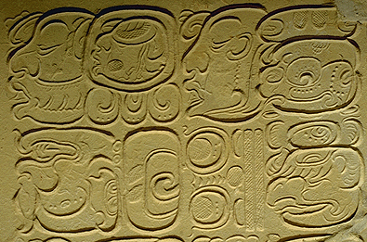
The Mayans

Slide 2
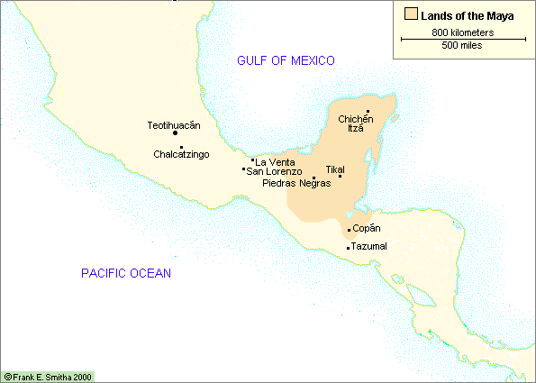
Lands of the Mayans
The Yucatan Peninsula
Primarily in Southern Mexico and Guatemala

Slide 3
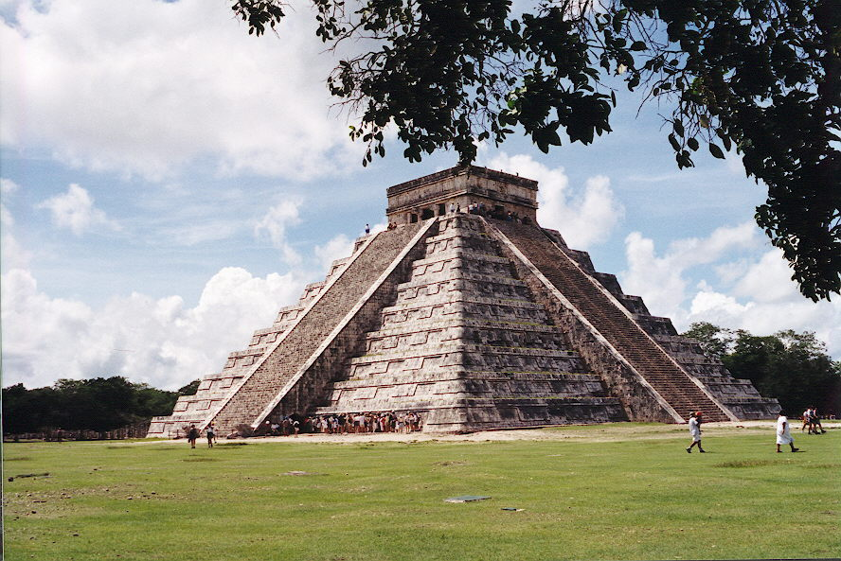
Chichen-Itza - Pyramid

Slide 4
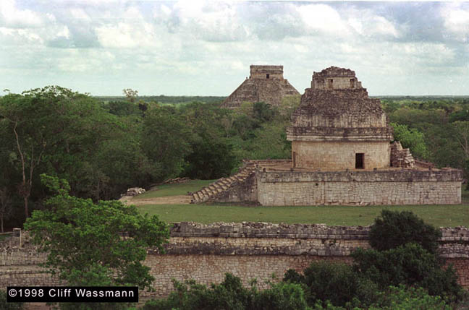
Chichen-Itza - Observatory
Xux Ek – “Great Star” (path of Venus)
chi’ ibal kin – “to eat the sun” (predict eclipses)

Slide 5
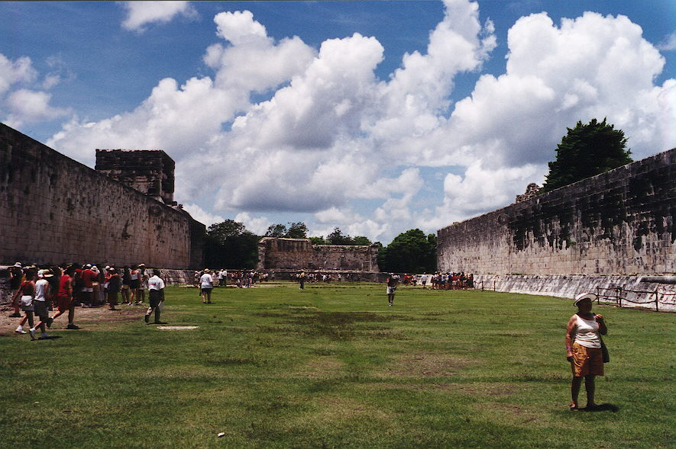
Chichen-Itza - Ball Court

Slide 6
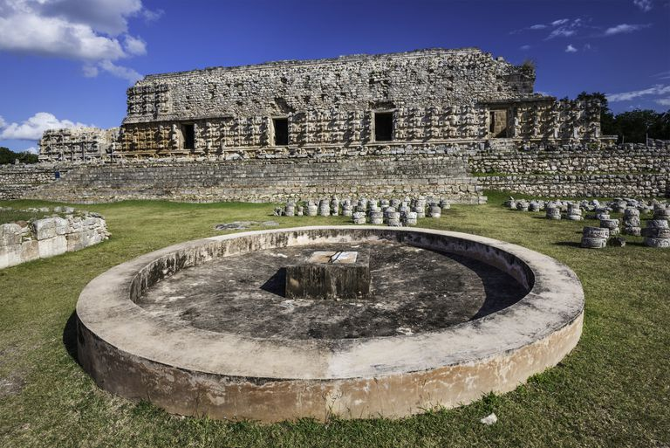
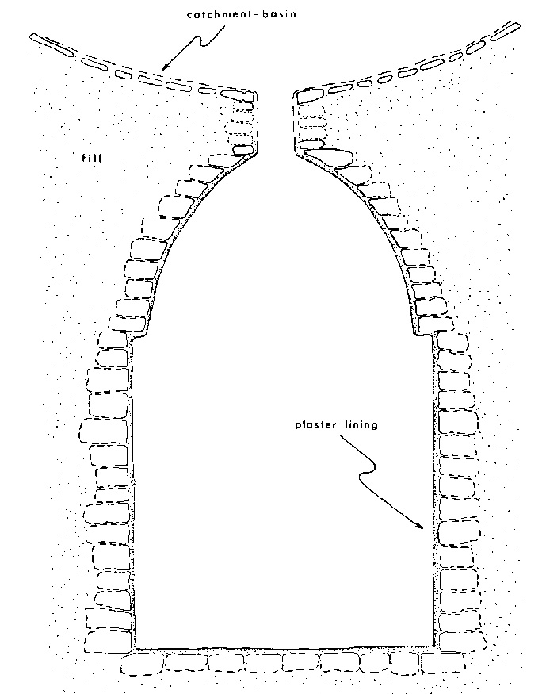
Mayan Underground Cisterns: Chultunes

Slide 7
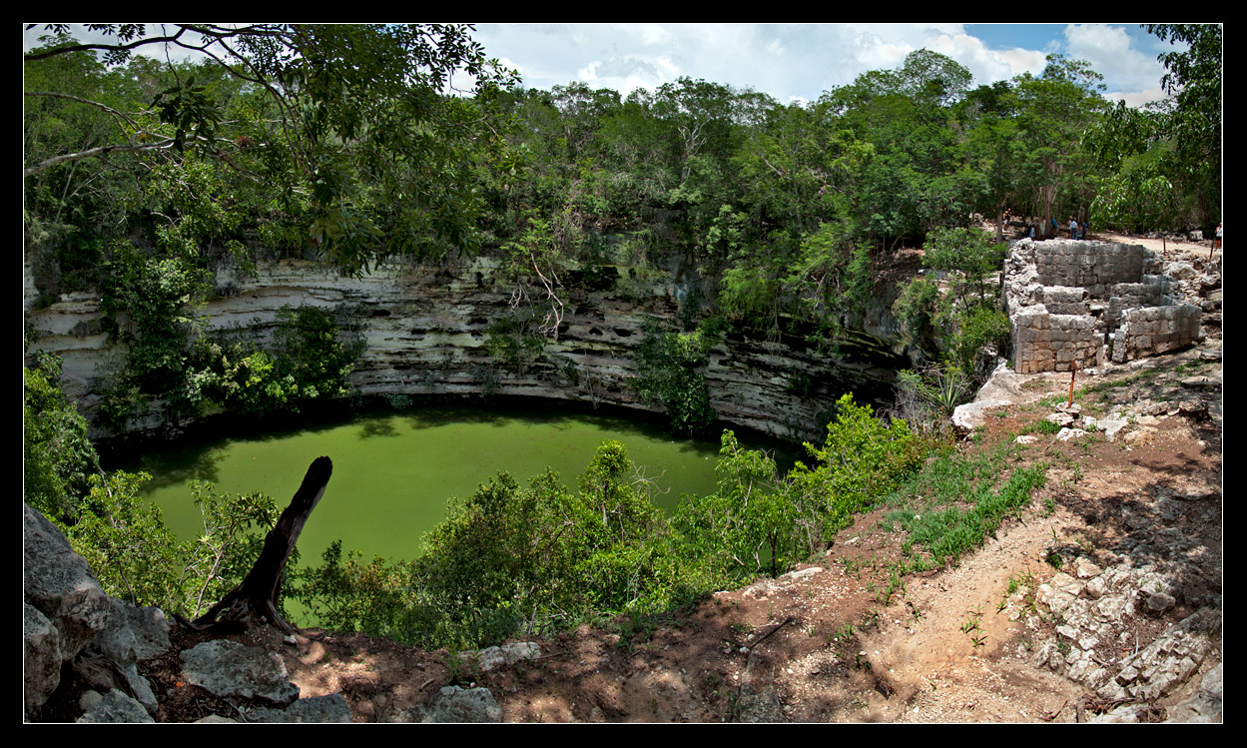
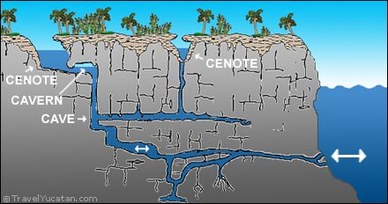
Cenotes – Natural Wells

Slide 8
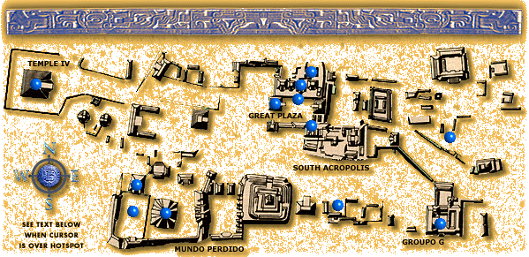
Overview of Tikal (Guatemala)
Temple of the Masks

Slide 9
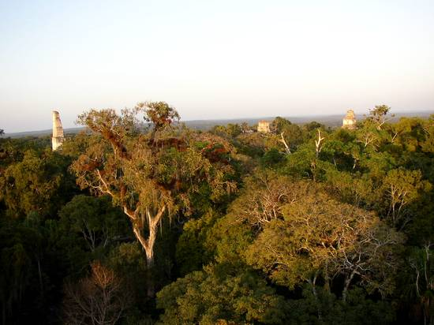
Tikal Jungle View

Slide 10
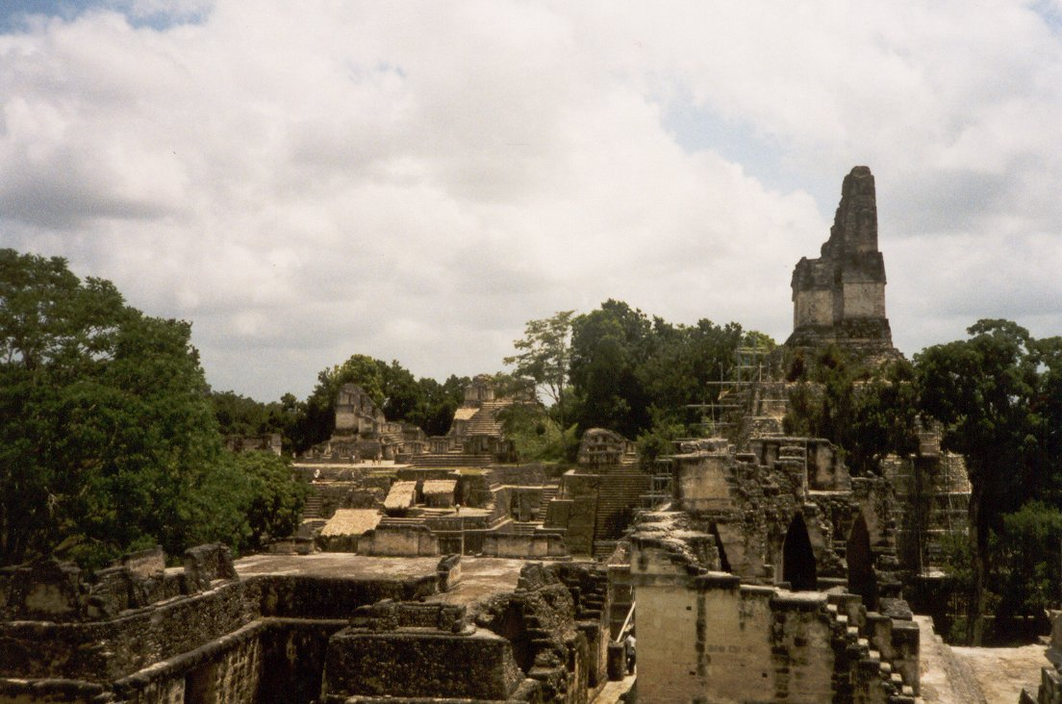
Tikal - Main Court

Slide 11
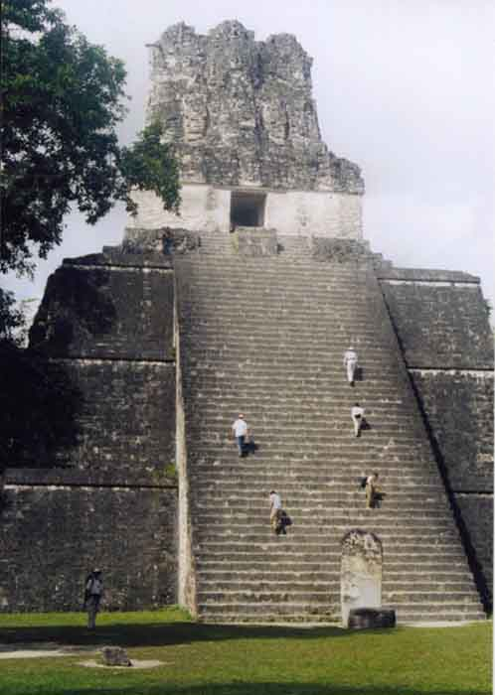
Tikal: Temple of the Masks

Slide 12
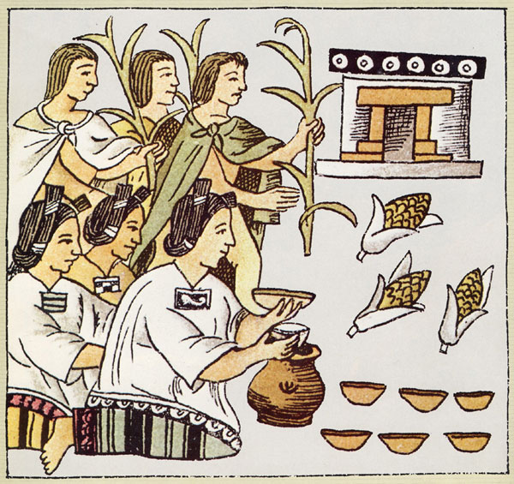
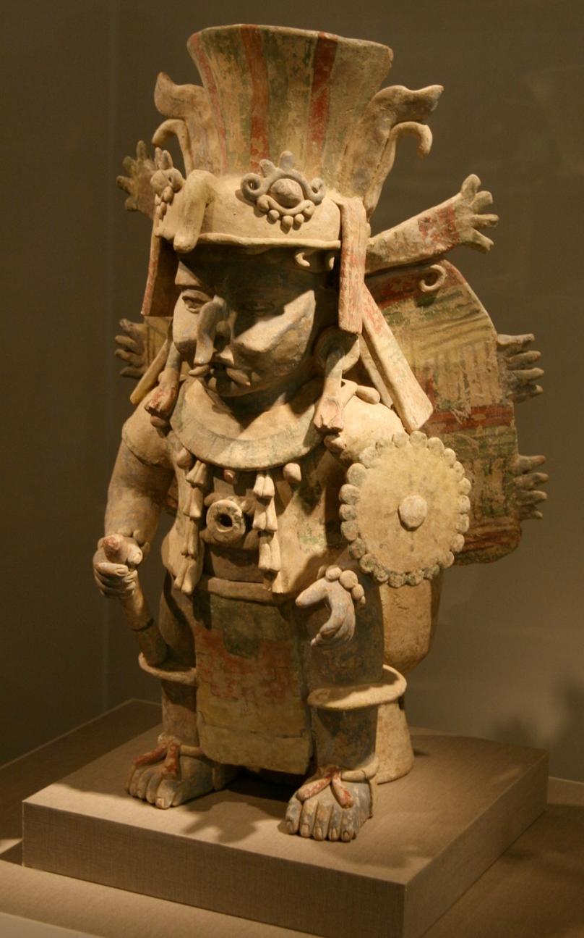
Mayan Cultivation of Maize
Chaahk, Lord of the Rains and Wind -->

Slide 13
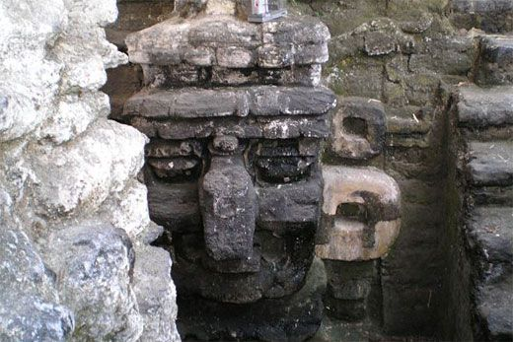
Tikal - Wall Mask of the Rain God (Chaahk)

Slide 14
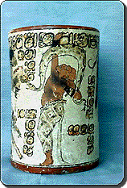
Mayan Drinking Cup for Chocolate
Crushed cocoa beans, chili peppers, and water
Drank at religious ceremonies (also at home)

Slide 15
Mayan Glyphs
sky king house child city
Mayan Mathematics
Allowed highly accurate astronomical predictions

Slide 16
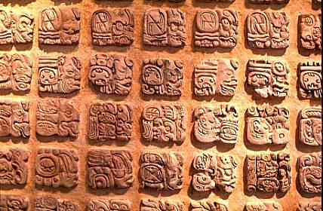
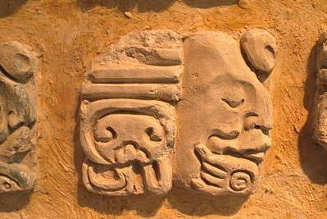
Mayan Glyphs

Slide 17
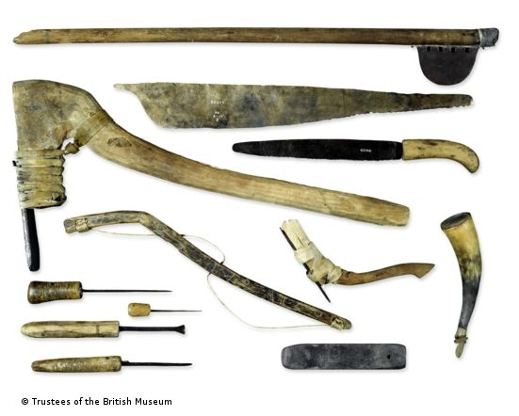
Mayan Weapons and Tools
Primarily used wood, stone, obsidian, bone
Had bows, spears, clubs, and quilted armor

Slide 18
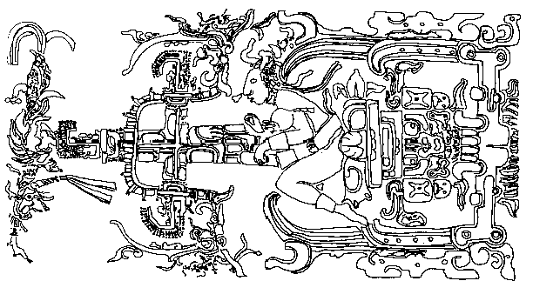
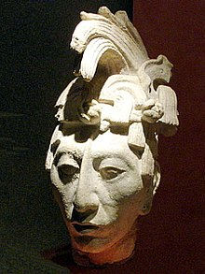
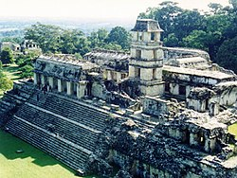
Pakal - The Mayan Astronaut
Ajaw (priest-king) of Palenque 615 – 683 A.D.
Made Palenque regional power
Expanded palace to make one of architectural wonders of Maya

Slide 19
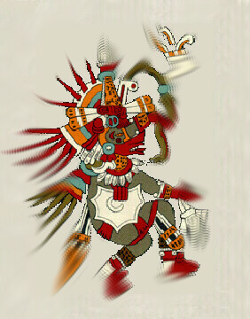
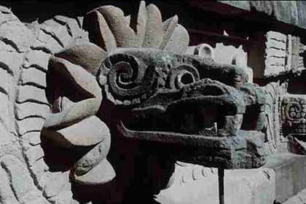
Kukulcan: The God of Wisdom & Learning
Feathered Serpent God
Created humanity and taught Mayans about civilization
Known later to the Aztecs as Quetzalcoatl

Slide 20
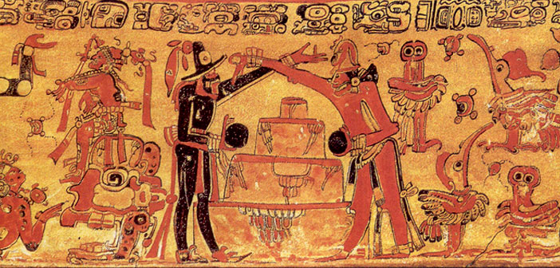
Popol Vuh: Creation Myth
World is created
Hunahpu and Xbalanque (the Hero Twins of Heaven)
Gain revenge against gods that killed their father and uncle
Human beings are then made from Maize

