Slide 1
ISLAM:
Submission
to the
Will of Allah
By: Ms. Susan M. Pojer Horace Greeley HS Chappaqua, NY

Slide 2
The
Judeo-Christian
Foundations
of Islam

Slide 3
Islam→An Abrahamic Religion
Muslims are strict monotheists.
They believe in the Judeo- Christian God, which they call Allah.
Muslims believe that the Torah and the Bible, like the Qur’an, is the word of God.
Peoples of the Book

Slide 4
Abraham’s Genealogy
HAGAR
ABRAHAM
SARAH
Ishmael
Isaac
12 Arabian Tribes
Jacob
Esau
12 Tribes of Israel

Slide 5
The Prophetic Tradition
Adam
Noah
Abraham
Moses
Jesus
Muhammad

Slide 6
The Qur'an:
God's Last
Revelation

Slide 7
The Origins of the Qur’an
Muhammad received his first revelation from the angel Gabriel in the Cave of Hira in 610.
622 → Hijrah → Muhammed flees Mecca for Medina. * The beginning of the Muslim calendar (1 A.H.)
Muhammad’s revelations were compiled into the Qur’an after his death.

Slide 8
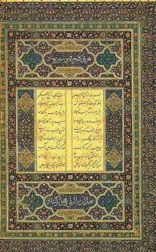
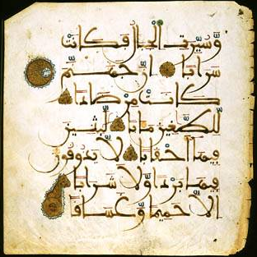
The Qur’an
Muslims believe it contains the word of God.
114 suras (chapters).
In the name of Allah, the compassionate, the merciful.
Written in Arabic.

Slide 9
The
Five Pillars
of
Islam

Slide 10
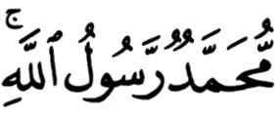
1. The Shahada
The testimony.
The declaration of faith:
There is no god worthy of worship except God, and Muhammad is His Messenger [or Prophet].
1

Slide 11
2. The Salat
The mandatory prayers performed 5 times a day: * dawn * noon * late afternoon * sunset * before going to bed
Wash before praying.
Face Mecca and use a prayer rug.
2

Slide 12
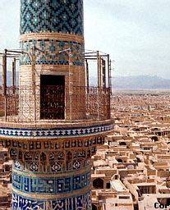
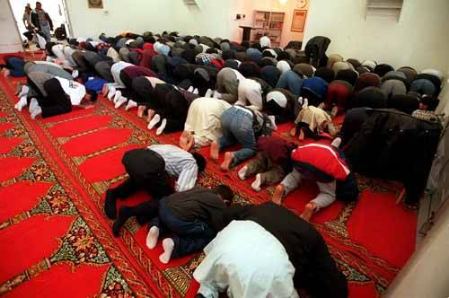
2. The Salat
The call to prayer by the muezzin in the minaret.
Pray in the mosque on Friday.
2

Slide 13
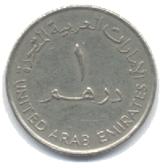
3. The Zakat
Almsgiving (charitable donations).
Muslims believe that all things belong to God.
Zakat means both “purification” and “growth.”
About 2.5% of your total wealth
3

Slide 14
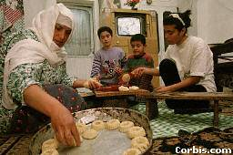
4. The Sawm
Fasting during the holy month of Ramadan.
Considered a method of self- purification.
No eating or drinking from sunrise to sunset during Ramadan.
4

Slide 15
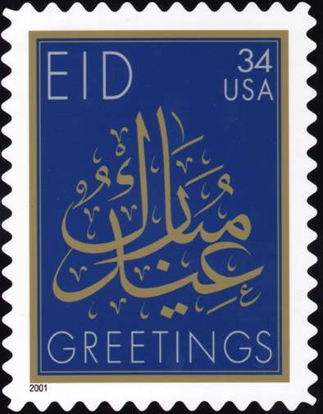
Eid Mubarak
End of the Ramadan holiday.

Slide 16
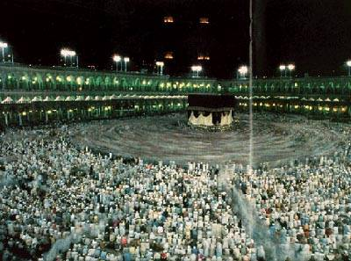
5. The Hajj
The pilgrimage to Mecca.
Must be done at least once in a Muslim’s lifetime.
2-3 million Muslims make the pilgrimage every year.
5

Slide 17
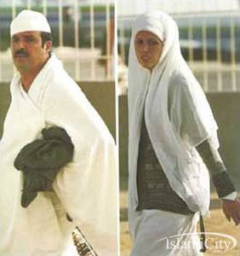
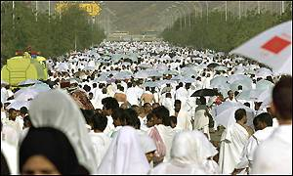
5. The Hajj
Those who complete the pilgrimage can add the title hajji to their name.
5

Slide 18
The Dar al-Islam
The World of Islam
1
2
3
4
5

Slide 19
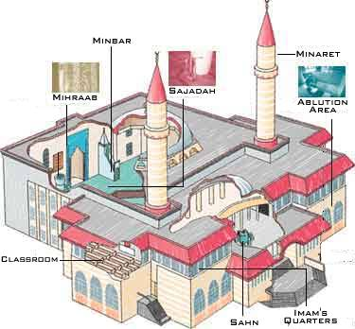
The Mosque
The Muslim place of worship.

Slide 20
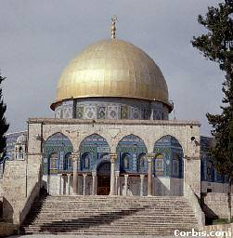
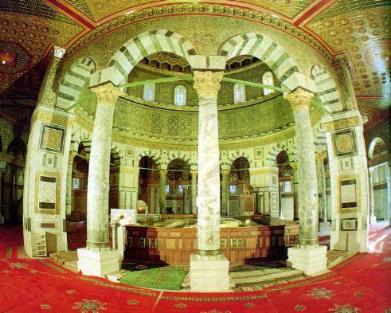
The Dome of the Rock Mosque in Jerusalem
Mount Moriah Rock where Muhammad ascended into heaven.

Slide 21
Other Islamic Religious Practices
Up to four wives allowed at once.
No alcohol or pork.
No gambling.
Sharia → body of Islamic law to regulate daily living.
Three holiest cities in Islam: * Mecca, Medina, Jerusalem.

Slide 22
Essential Question:
Why was Islam able to spread so quickly and convert so many to the new religion?

Slide 23
The Spread of Islam
Easy to learn and practice.
No priesthood.
Teaches equality.
Non-Muslims, who were “Peoples of the Book,” were allowed religious freedom, but paid additional taxes.
Easily “portable” → nomads & trade routes.
Jihad (“Holy War”) against pagans and other non-believers (“infidels”).

Slide 24
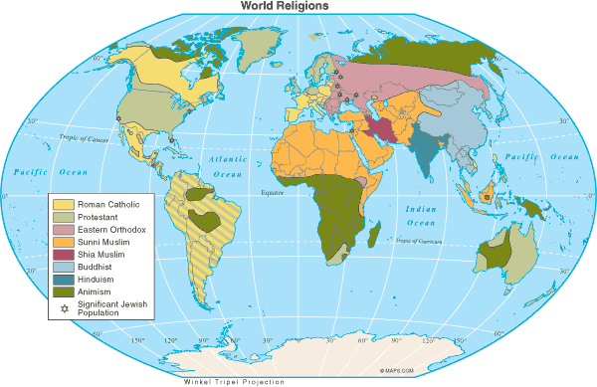
Muslims in the World Today

Slide 25
Countries with the Largest Muslim Population
1. | Indonesia | 183,000,000 | 6. | Iran | 62,000,000
2. | Pakistan | 134,000,000 | 7. | Egypt | 59,000,000
3. | India | 121,000,000 | 8. | Nigeria | 53,000,000
4. | Bangladesh | 114,000,000 | 9. | Algeria | 31,000,000
5. | Turkey | 66,000,000 | 10. | Morocco | 29,000,000
* Arabs make up only 20% of the total Muslim population of the world.

Slide 26
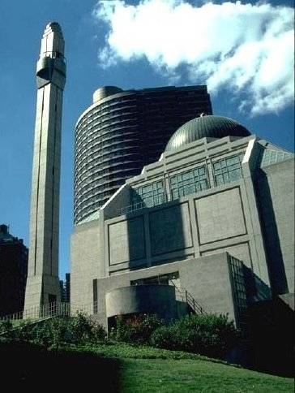
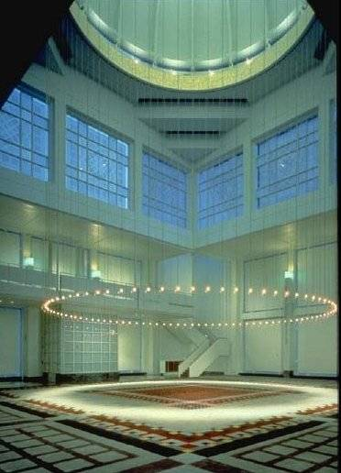
Muslim Culture in NYC
The Islamic Center, New York City

Slide 27
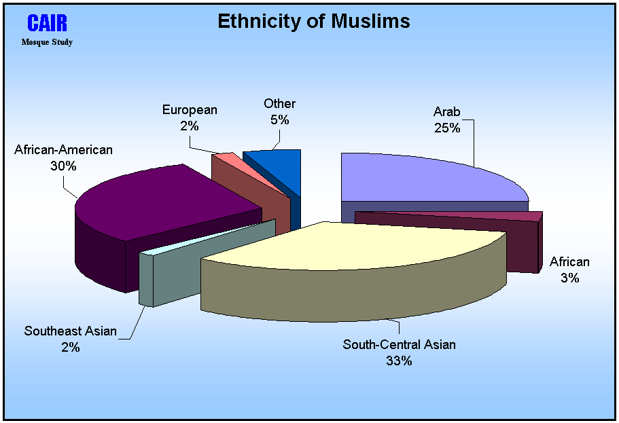

Slide 28
Islam After
September 11 and ISIS?

