Slide 1
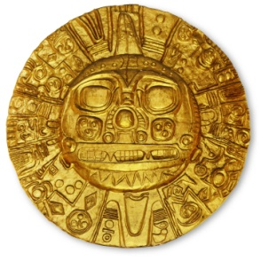
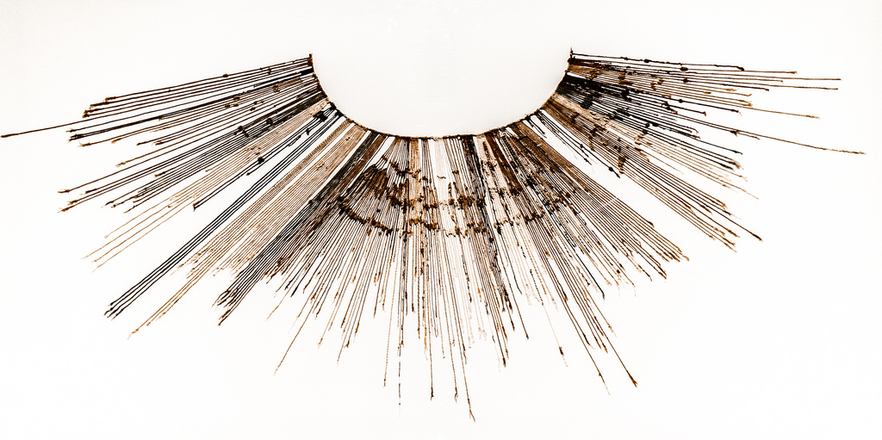
THE INCA
I
N
C
A
Mr. Millican’s Humanities Class

Slide 2
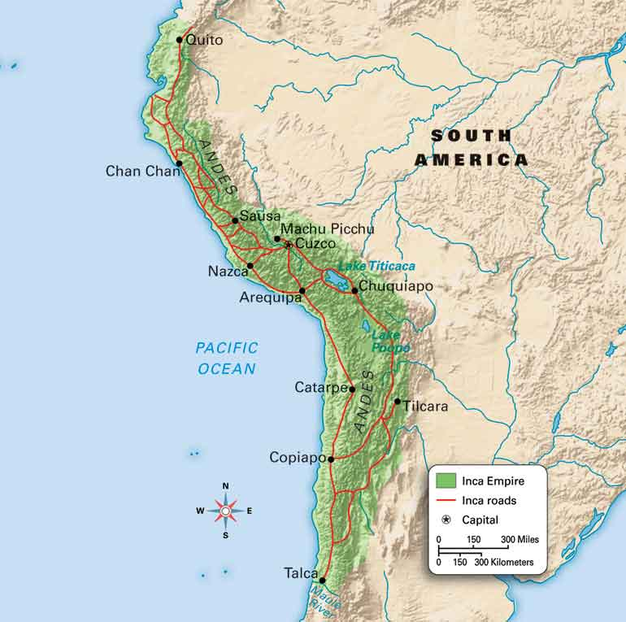
Geography
I
N
C
A
Empire ran along Pacific Coast and Andes Mountains of South America

Slide 3
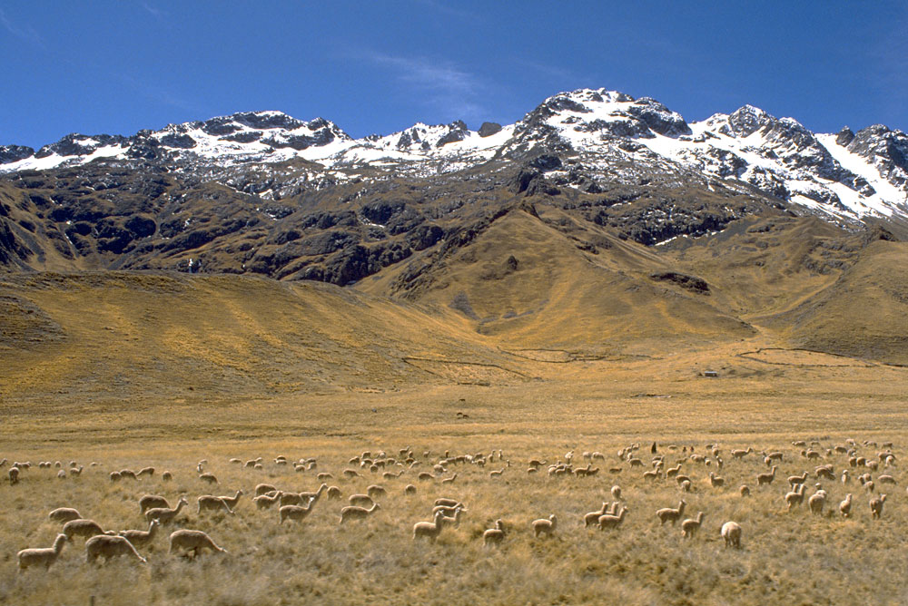
Geography
I
N
C
A
Much of the empire existed in the altiplano, or high plains, that were coldest and driest in the west

Slide 4
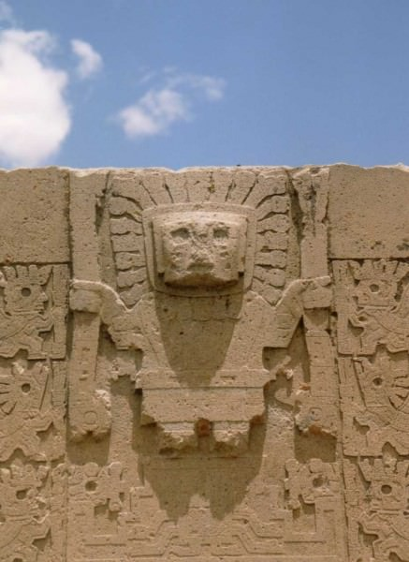
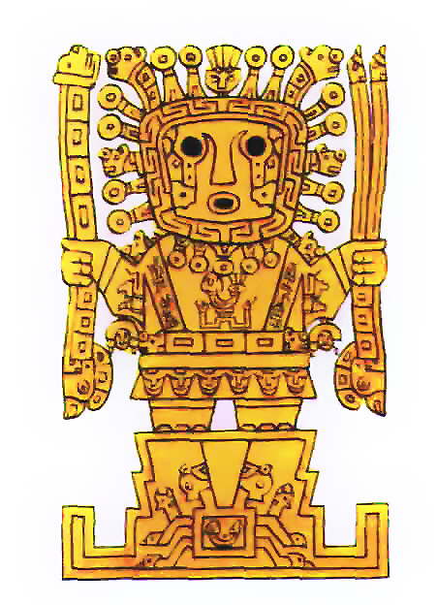
Religion
I
N
C
A
Inca god Viracocha lived on Island of Sun in Lake Titicaca and created humanity, sun, moon and stars

Slide 5
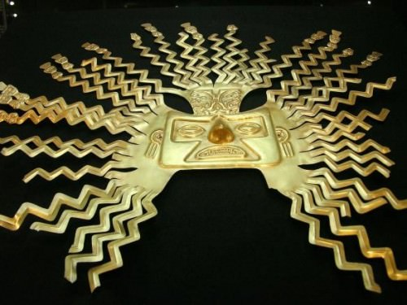
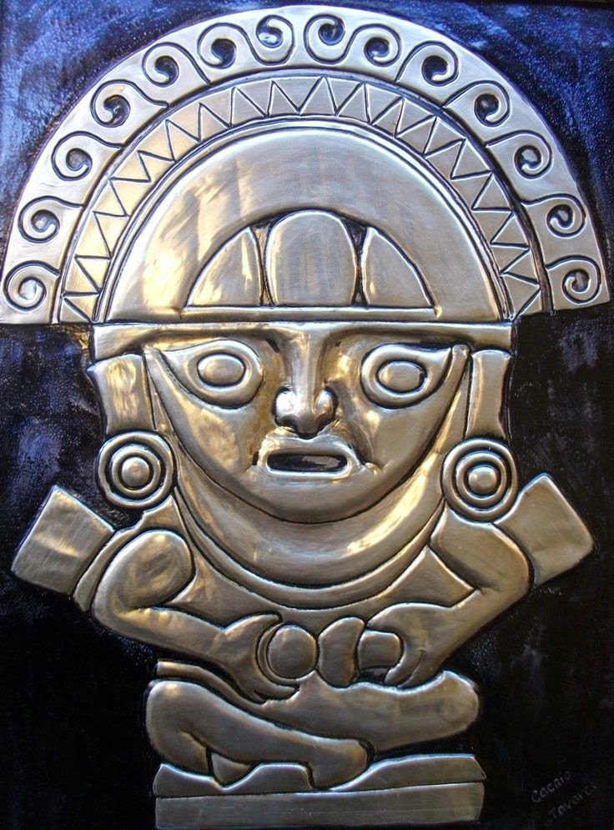
Religion
I
N
C
A
Inti, the sun god, was responsible for harvests
Mama Quilla, the moon god, ruled time

Slide 6
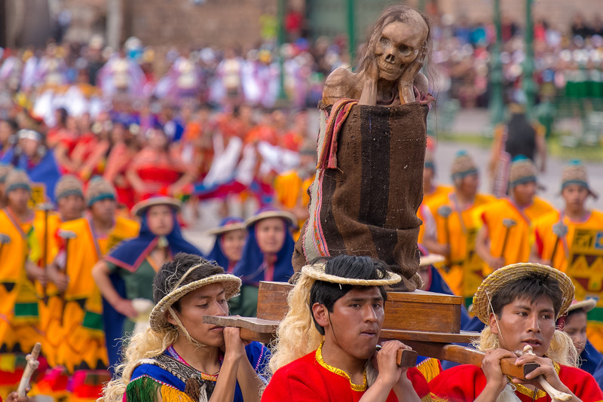
Religion
I
N
C
A
Mummies were often brought out for religious festivals to partake in the celebration
Inti Raymi most important festival in June – beginning of ploughing season

Slide 7
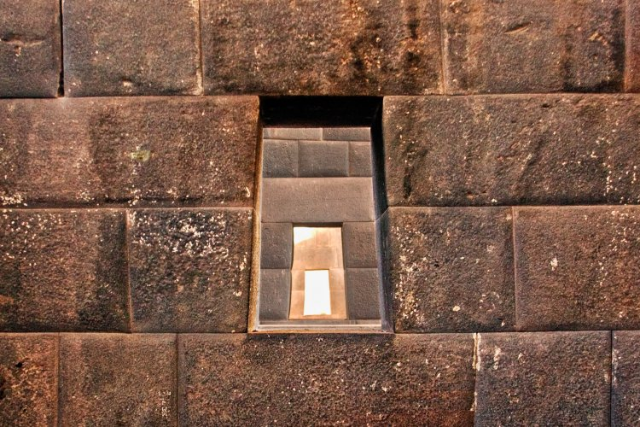
Achievements
I
N
C
A
Inca were incredible masons, fitting stones together without mortar in buildings that have withstood repeated earthquakes over 500 years

Slide 8
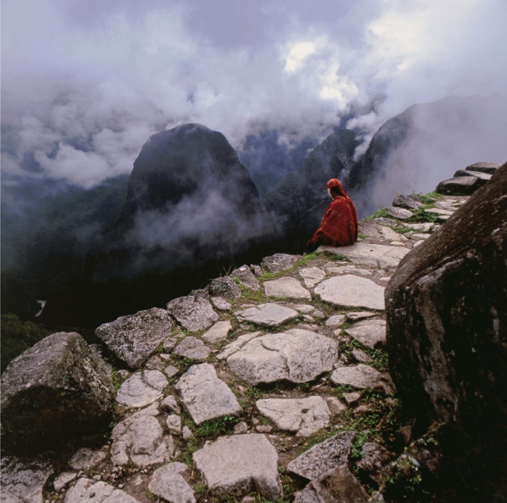
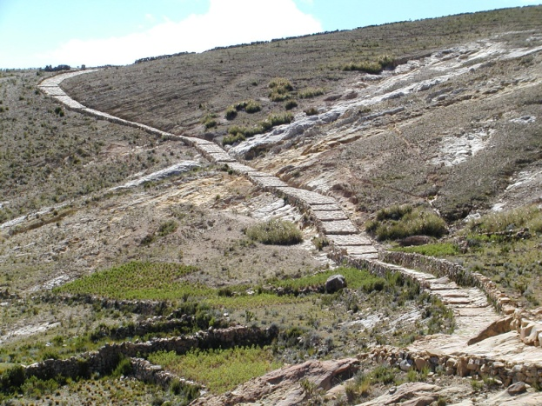
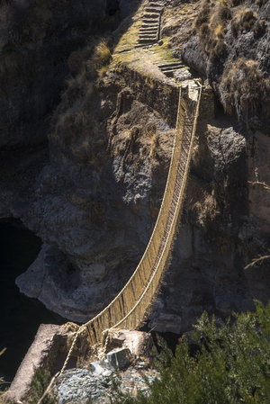
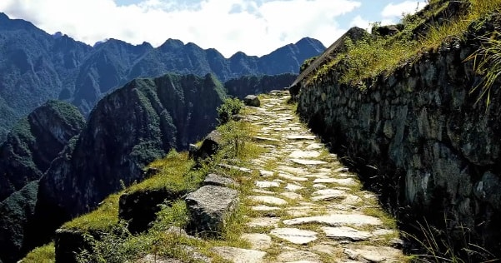
Achievements
I
N
C
A
Inca built over 20,000 miles of paved roads and woven grass bridges

Slide 9
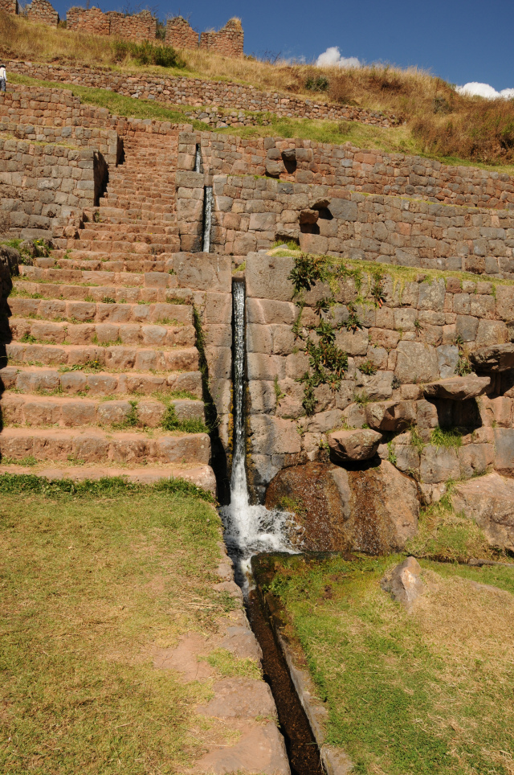
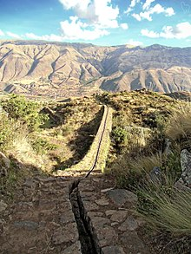
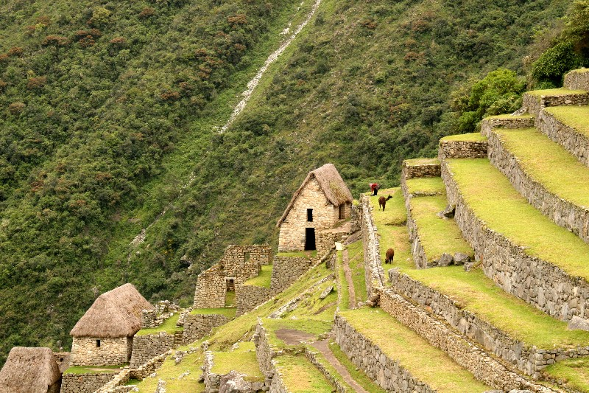
Achievements
I
N
C
A
Advanced terrace and irrigation systems allowed an agricultural surplus to support a vast empire

Slide 10
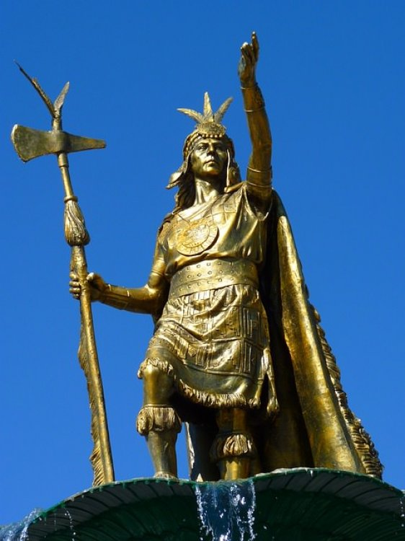
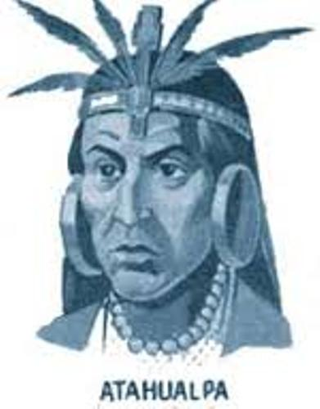
Political System
I
N
C
A
Emperor was son of Inti and ruled the government and army – kin group ran empire

Slide 11
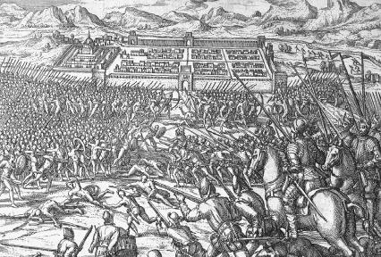
Political System
I
N
C
A
The Inca (never more than 100,000) offered gifts, then threats, and then slaughtered opponents
Subjects allowed to keep gods and administration
Tokrikoq, or regional administrators, always Inca

Slide 12
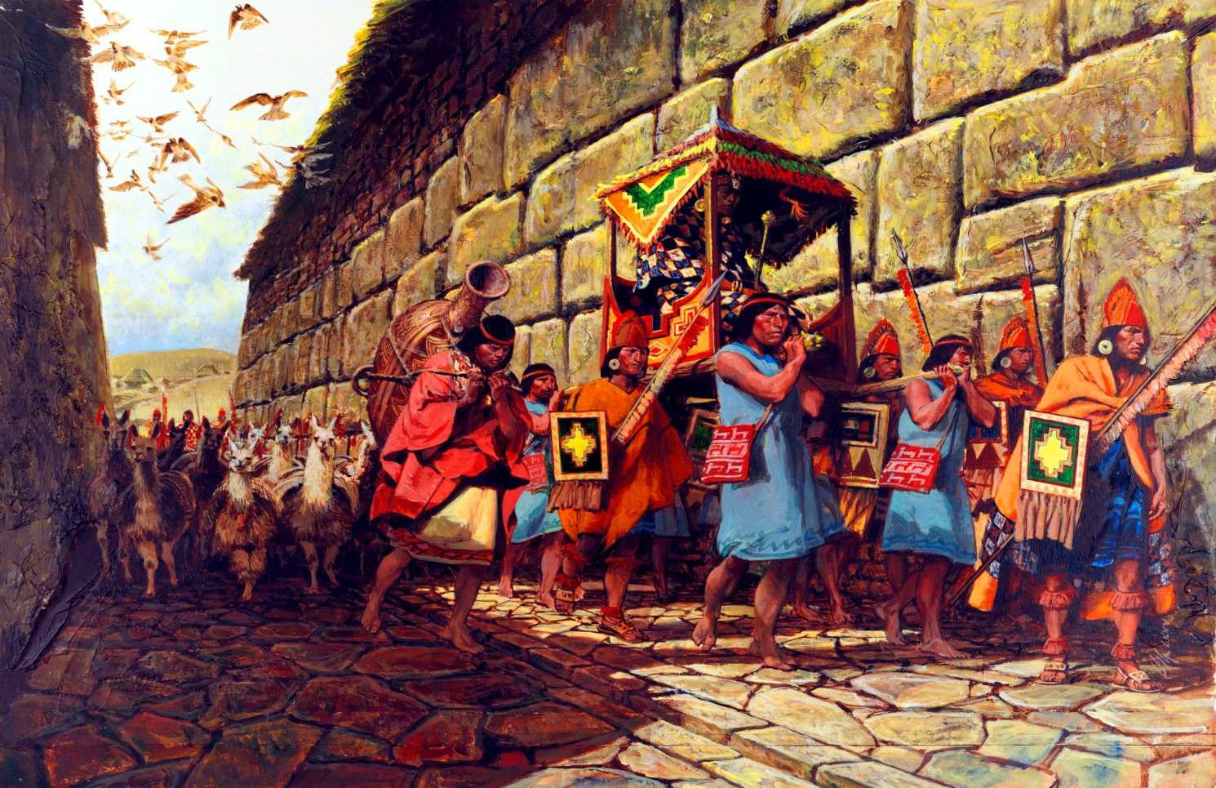
Political System
I
N
C
A
Sons of conquered rulers were brought back to Cuzco as hostages and then educated as Incas
Instituted Mitima, or forced relocation, to reduce chance of rebellion with most unruly subjects

Slide 13
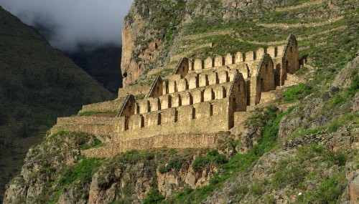
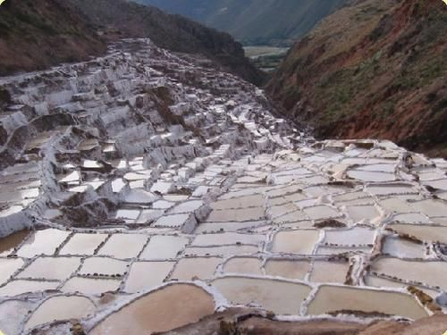
Economics
I
N
C
A
Mit’a was a labor tax that all people had to serve for a fixed time every year
All food was collected by government and then redistributed as needed from Qolloqa
Labor required by each region was tailored to their abilities (farming, building, weaving, etc.)

Slide 14
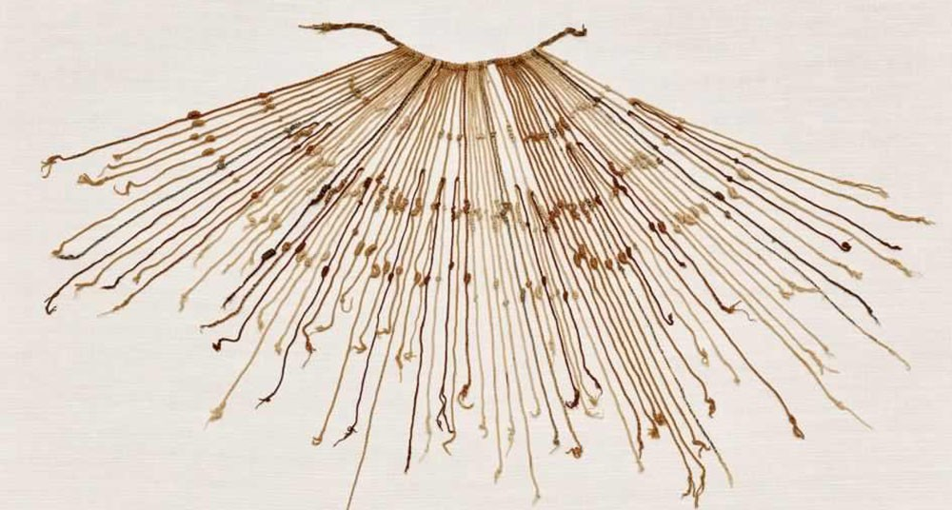
Economics
I
N
C
A
Quipu, a colored system of knots to record information was used by Inca to track goods
Inca economy was based on farming, building, and mining as directed by the state; not trade

Slide 15
Social Structure
Emperor and kin group
I
N
C
A
Nobles
Inca Commoners
Non-Inca subjects
Despite emperor’s status as son of god, he needed support of nobles to rule and could be assassinated
Slavery did not exist in Inca society due to Mit’a

