Slide 1
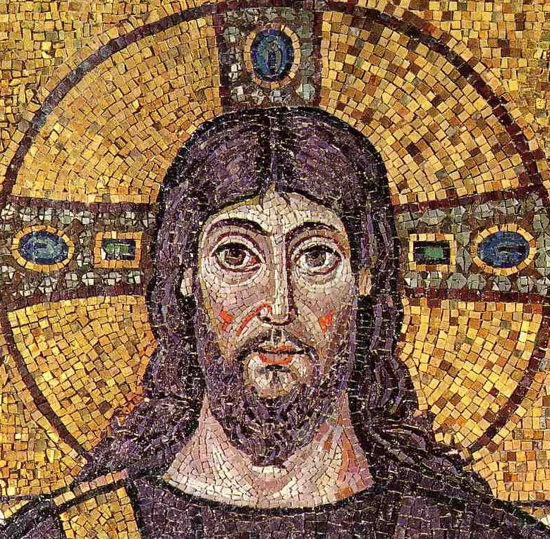
The Byzantine Empire

Slide 2
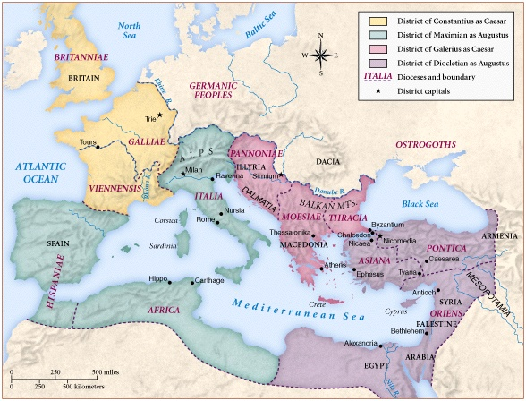
The Roman Empire Divided in 294
Diocletian divides empire to help administer the vast territory

Slide 3
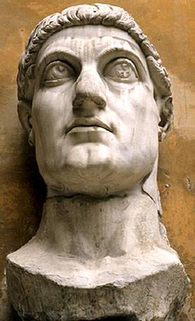
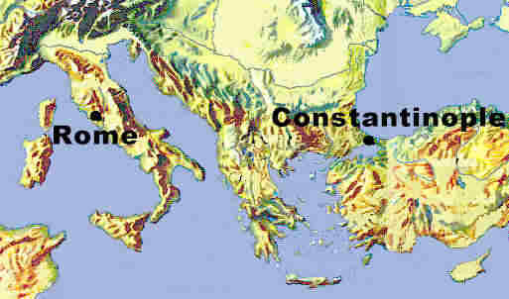
Constantine’s City--Constantinopolis
city founded at Greek Byzantium
Constantine recognizes the importance of eastern Mediterranean

Slide 4
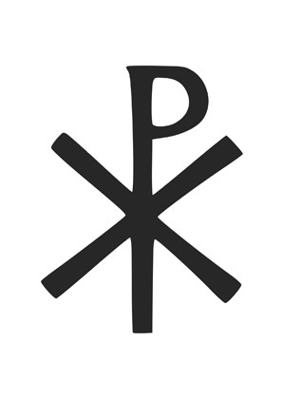
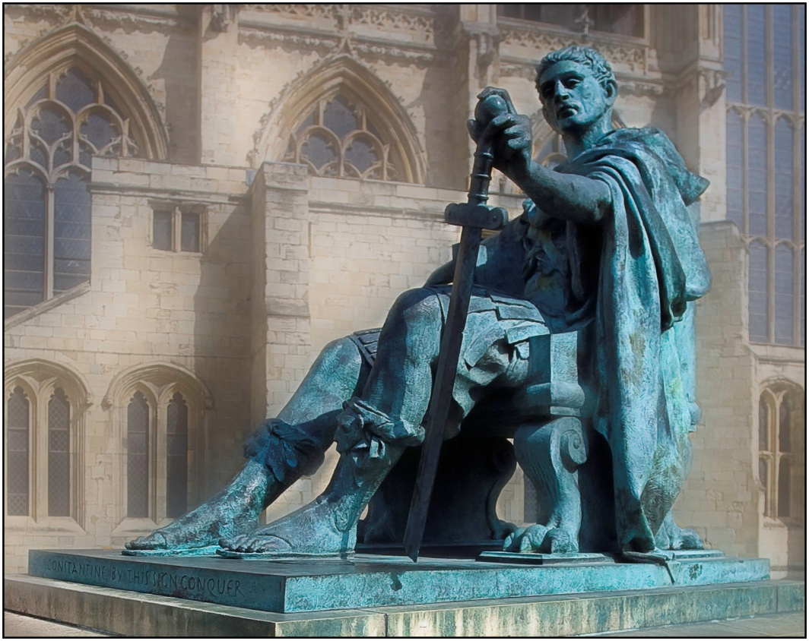
Constantine and Christianity
Battle of Milvian Bridge 312 AD
Edict of Milan 313 AD
Council of Nicea 325 AD
“liberty to follow that mode of religion which to each of them appeared best.”

Slide 5
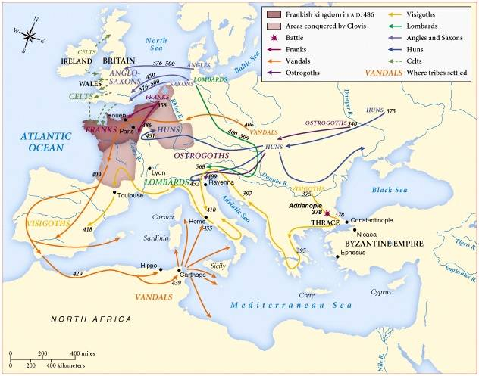
Barbarian Invasions of the Roman Empire

Slide 6
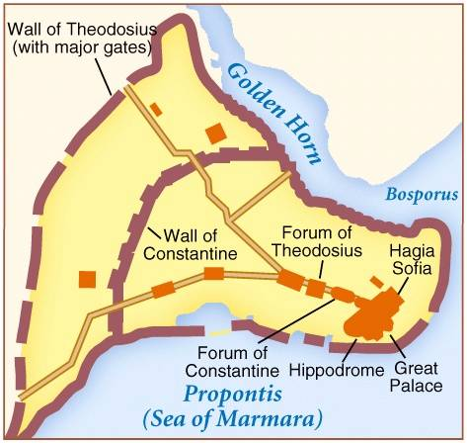
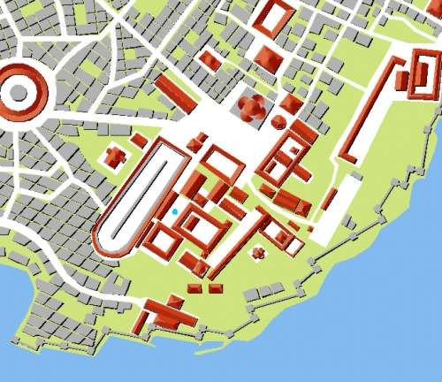
Constantinople: A Greek City (Istanbul Today)

Slide 7
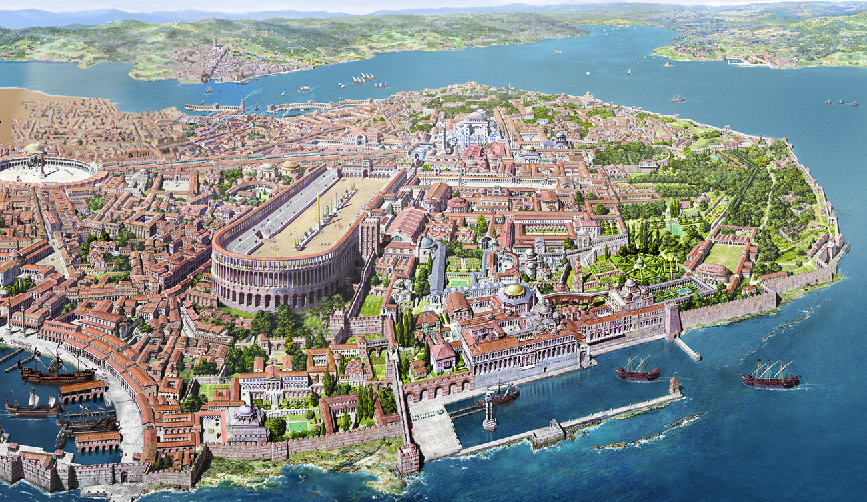
Constantinople
Controlled crossing from Asia to Europe at Bosporus
Built lavishly with marble palaces, baths, churches, museums

Slide 8
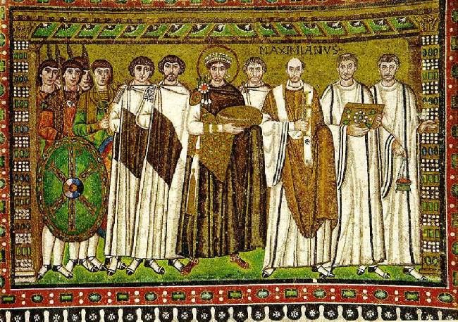
Emperor Justinian [r. 527-564]
Humble origins
Macedonian
Originally advisor to Justin I (his uncle) , later adopted
“Emperor who never sleeps”

Slide 9
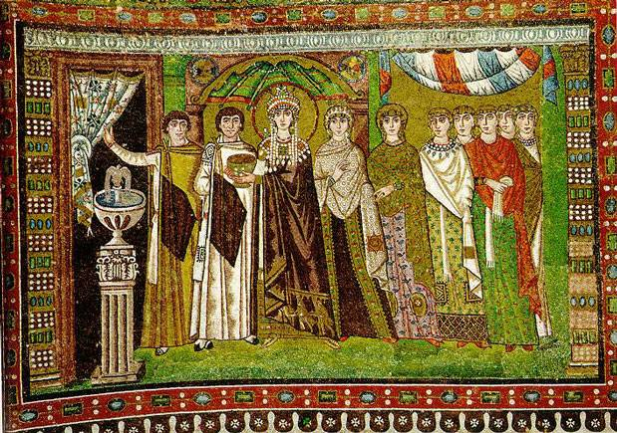
Empress Theodora
Humble origins
Actress
Justinian’s primary advisor
Key role in Nika Revolt

Slide 10
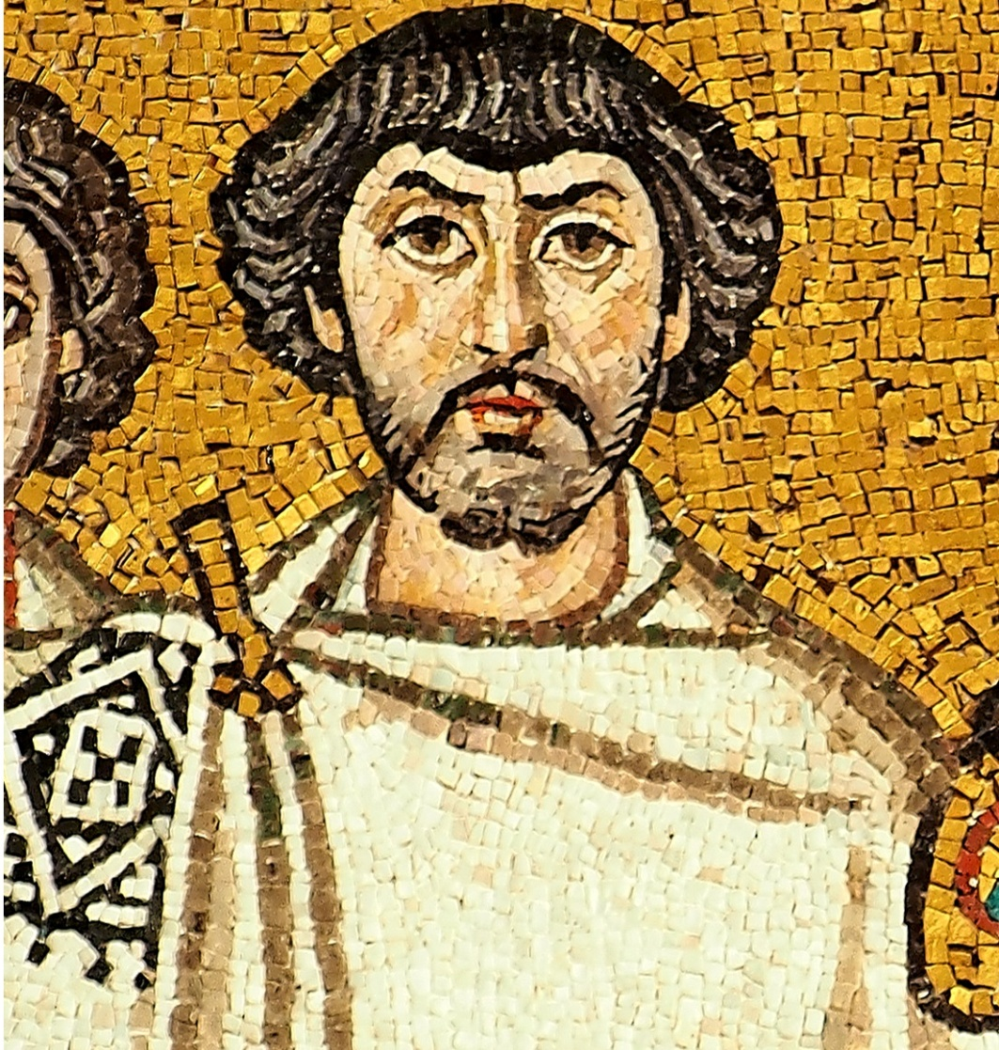
Belisarius
Macedonian
Multi-purpose units
“Eternal Peace”
Nika Revolts
Italian Campaign

Slide 11
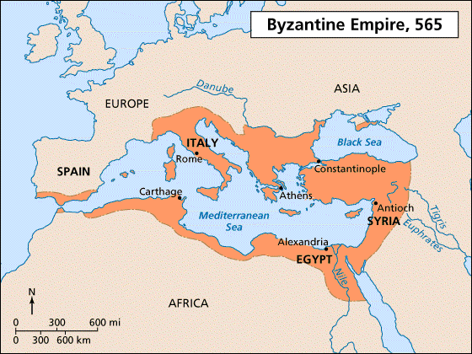
Justinian’s Empire at its Peak

Slide 12
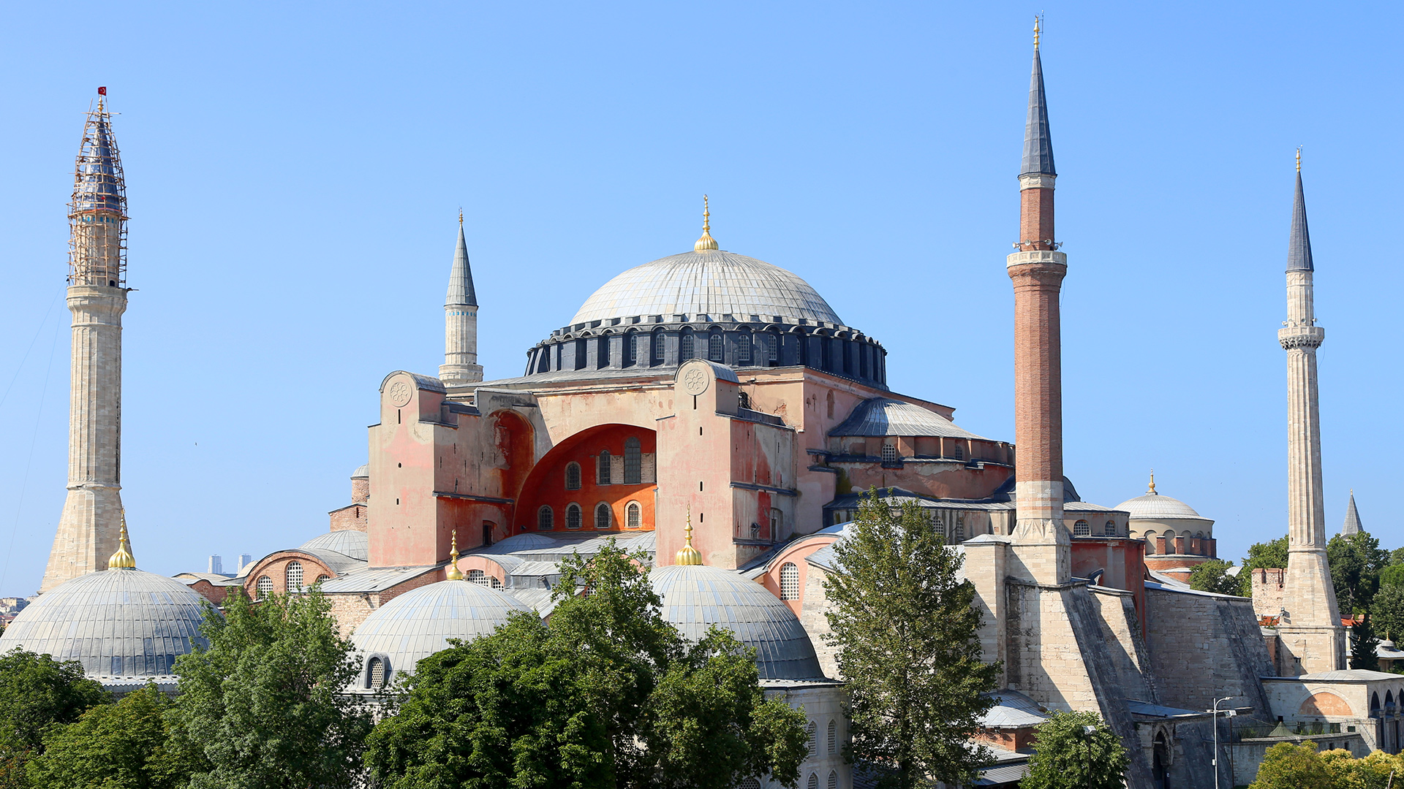
Church of Hagia Sophia [Holy Wisdom]

Slide 13
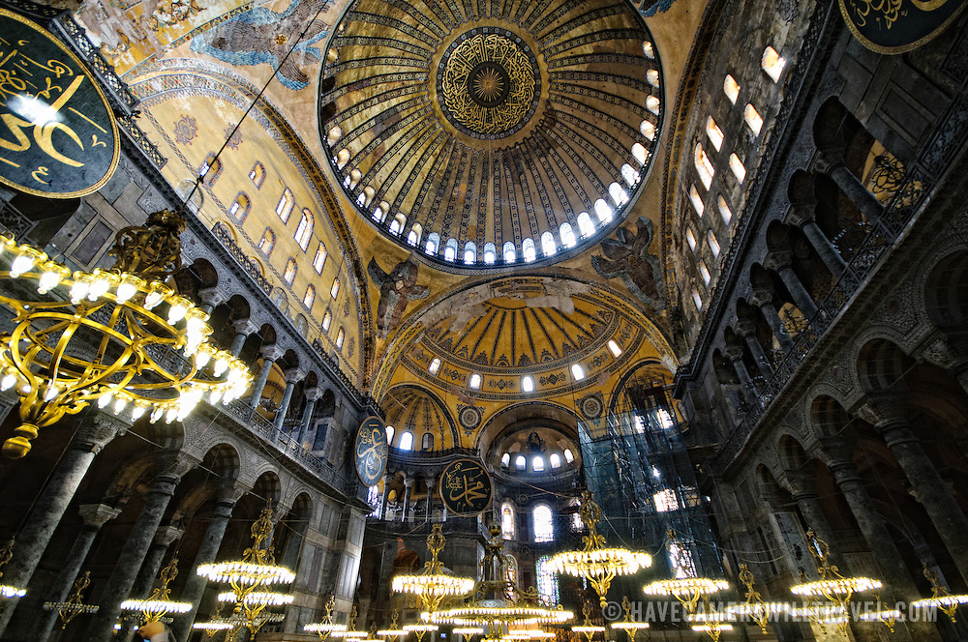
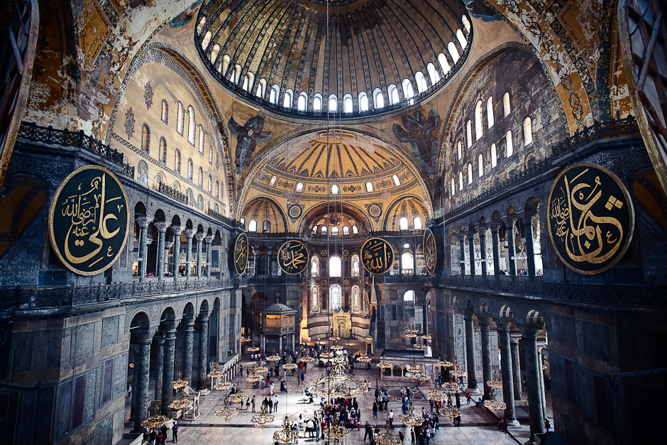
Interior of the Church of Hagia Sophia

Slide 14
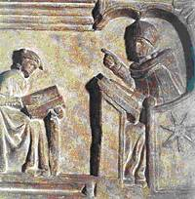
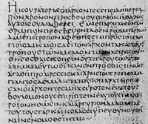
Justinian’s Code
Corpus Juris Civilis:
1. Digest (selected cases)
2. Institutes (law students)
3. New Code (Justinian)

Slide 15
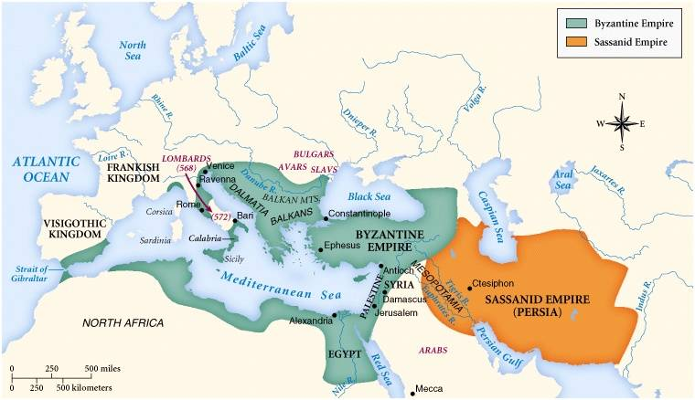
Byzantine & Sassanid Empires, 6^{c}

Slide 16
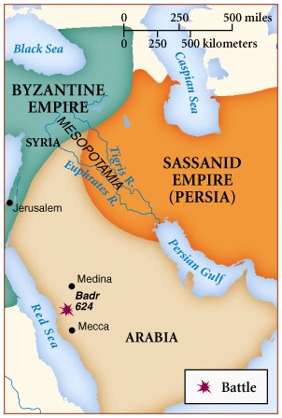
7th Century Arabia:
^{A Threat to the Great Empires?}
?

Slide 17
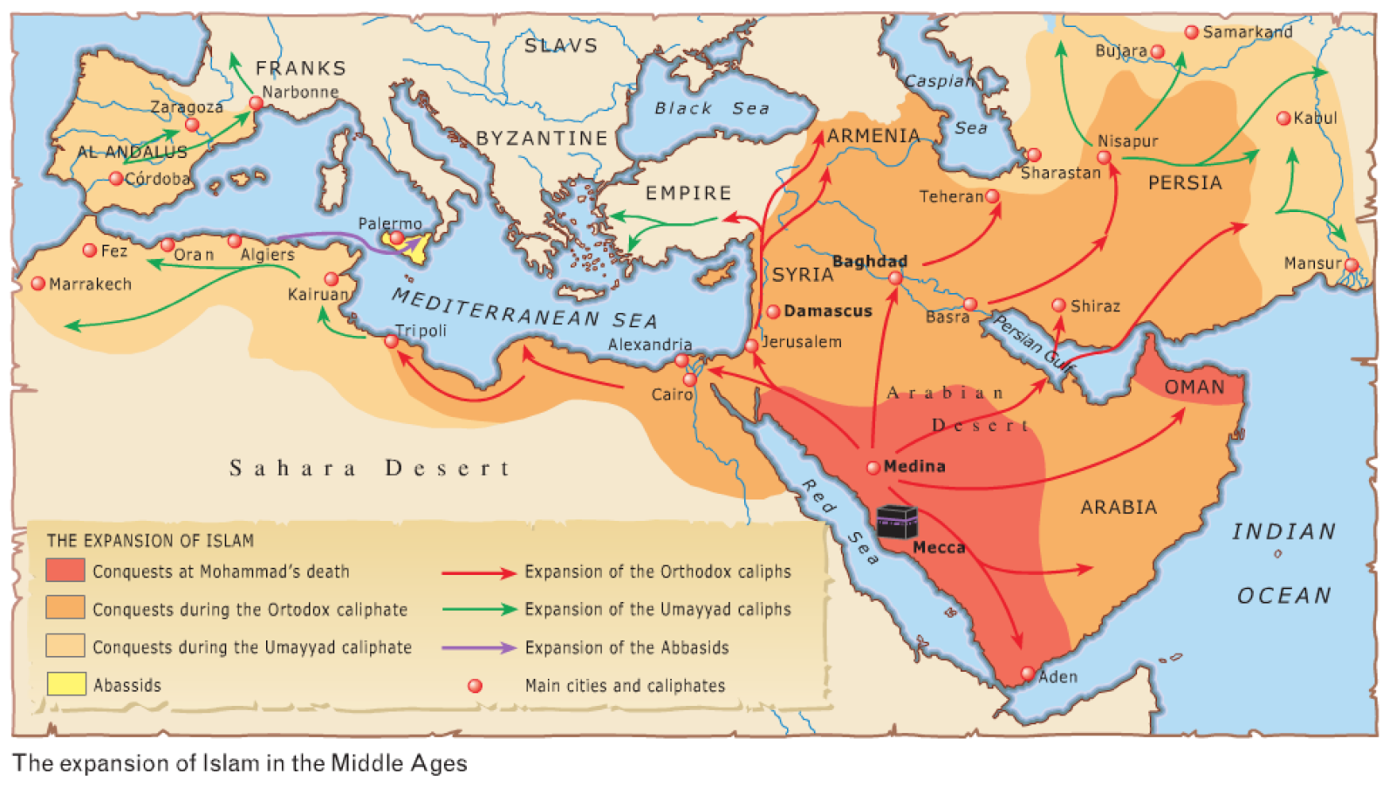
750 AD
Byzantine Empire loses Italy, Egypt, Bulgaria and Syria

Slide 18
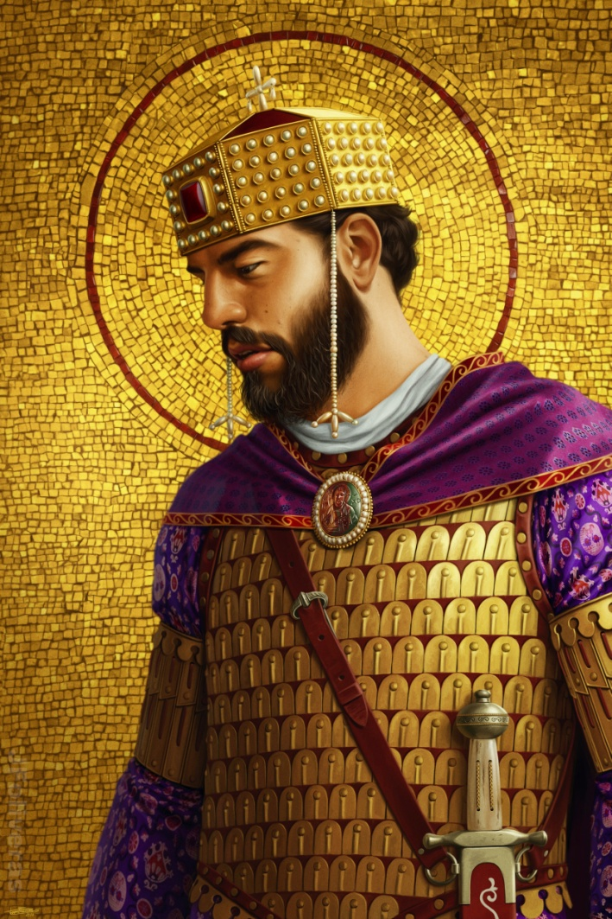
Basil II
Empire steadily declined in wealth and territory until 976 AD
Basil the Bulgar Slayer ruled for 49 years and restored much of the empire’s wealth

Slide 19
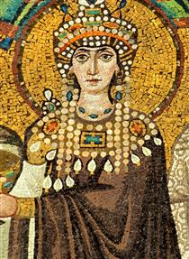
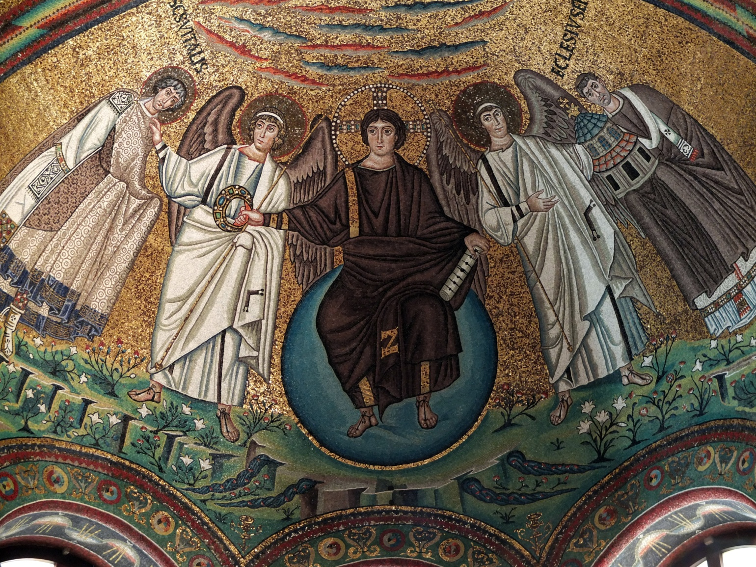
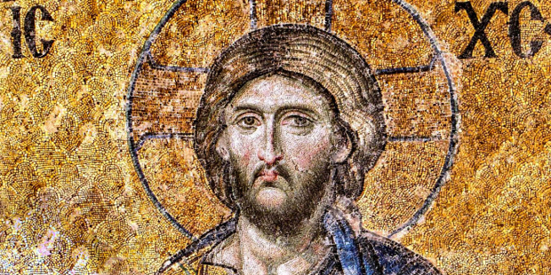
Byzantine Mosaics

Slide 20
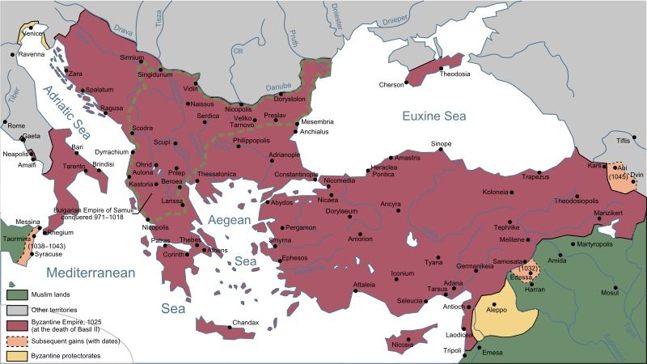
Byzantine Empire 1025AD

Slide 21
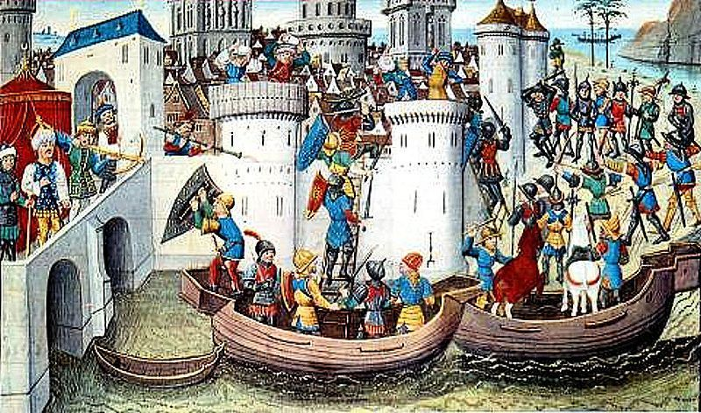
Fourth Crusade 1204 AD
Primarily French and Venetian force sacks the largest Christian city in the world

Slide 22
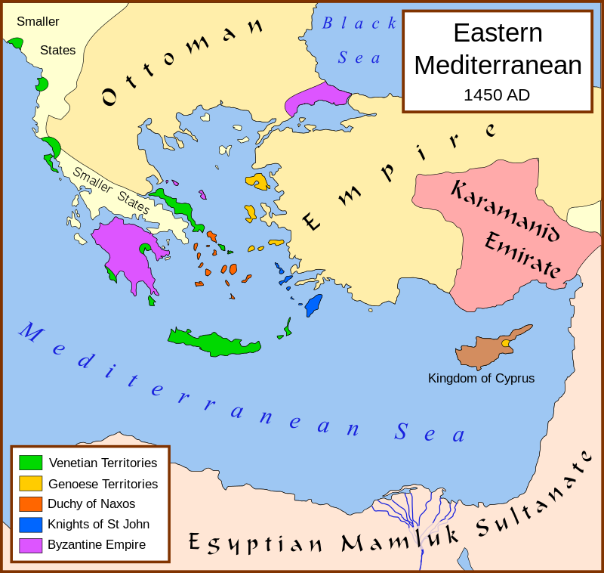
Byzantine Empire falls in 1453
Byzantine Empire never recovered from 4th Crusade and eventually falls to Ottoman Turks in 1453

